Slide 1

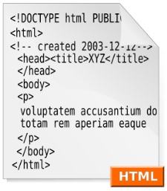



Web Technologies Basics
Concepts
HTML5
Telerik Software Academy
http://academy.telerik.com

Slide 2

Table of Contents
Web Sites and Web Applications
Web 1.0, 2.0, 3.0
Web Browsers
Hardware Servers
Web Servers
Client-Server Architecture
3-Tier / Multi-Tier Architectures
Service-Oriented Architecture (SOA)

Slide 3
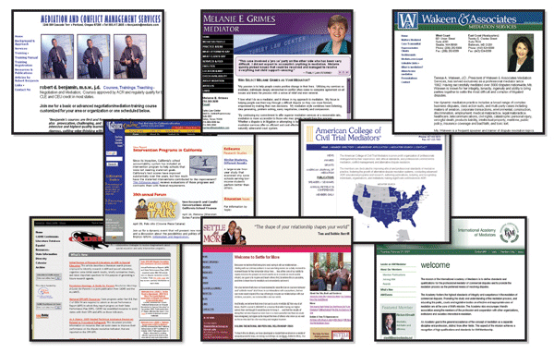
Web Sites and Web Applications

Slide 4
Web Page
Document or information resource that is suitable for the World Wide Web
Can be accessed through a web browser and displayed on a monitor or mobile device
This information is usually in HTML or XHTML format, and may provide navigation to other web pages via hypertext links
Web pages frequently refer to other resources such as style sheets (CSS), scripts (JavaScript) and images into their final presentation

Slide 5
Web Site
Collection of related web pages containing web resources (web pages, images, videos, CSS files, JS files or other digital assets)
Common navigation between web pages
A website is hosted on at least one web server
Accessible via a network (such as the Internet)
All publicly accessible websites collectively constitute the World Wide Web

Slide 6


Web Application
Next level web sites
High interactivity
High accessibility (Cloud)
AJAX, Silverlight, Flash, Flex, etc.
Applications are usually broken into logical chunks called "tiers", where every tier is assigned a role
Desktop-like application in the web browser
Web applications on desktop (Windows 8)

Slide 7



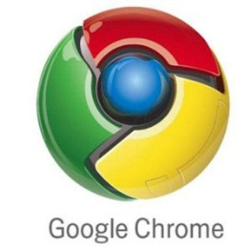


Web Browsers and Layout Engines

Slide 8
Web Browsers
Program designed to enable users to access, retrieve and view documents and other resources from the Web
Main responsibilities:
Bring information resources to the user (issuing requests to the web server and handling any results generated by the request)
Presenting web content (render HTML, CSS, JS)
Capable of executing applications within the same context as the document on view (Flash)

Slide 9
Layout Engines
Software component that displays the formatted content on the screen combining:
Marked up content (such as HTML, XML, image files, etc.)
Formatting information (such as CSS, XSL, etc.)
It "paints" on the content area of a window, which is displayed on a monitor or a printer
Typically embedded in web browsers, e-mail clients, on-line help systems or other applications that require the displaying (and editing) of web content
How Browsers Work

Slide 10


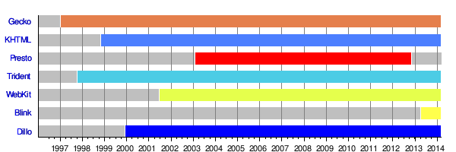



Layout Engines and Web Browsers
Trident-based
Internet Explorer, Netscape, Maxthon, etc.
Gecko-based
Firefox, Netscape, SeaMonkey, etc.
Blink-based
Chrome, Opera
WebKit-based
Safari, iOS, Maxthon, Chrome (up to v27), etc.
EdgeHTML (fork of Trident)
Spartan (the new IE)
Windows 10 and Windows 10 (Mobile)

Slide 11
User Agent Strings
Identify web browsers and their version
History of (in)compatibility attempts [link]
Can have some additional information like layout engine, user's operating system, etc.
Mozilla/5.0 – a generic term which most modern browsers use (originally indicated Netscape)
Windows NT 6.3 – Windows 8.1
WOW64 – Windows-On-Windows 64-bit
AppleWebKit/537.36 – Blink is a fork of WebKit
KHTML is the previous name of WebKit
Chrome/41.0.2272.118 – real browser version
Safari/537.36 – artifact against scripts sniffing
Mozilla/5.0 (Windows NT 6.3; WOW64) AppleWebKit/537.36 (KHTML, like Gecko) Chrome/41.0.2272.118 Safari/537.36

Slide 12
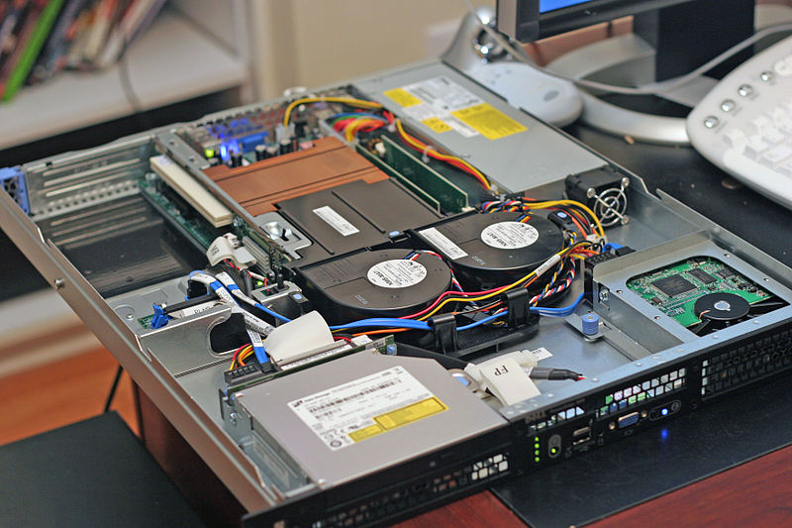
Hardware Servers

Slide 13
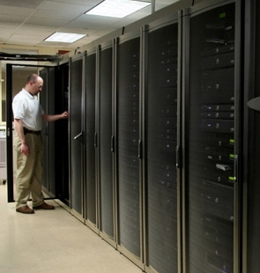
Hardware Servers
Physical computer (a hardware system) dedicated to running one or more such services
Servers are placed in collocation centers
Colocation facilities provide space, power, cooling, and physical security for the server
The server may be:
Database server
File server
Mail server
Print server
VPS servers

Slide 14




Web Servers
Apache, IIS, nginx, lighttpd, etc.

Slide 15
What Do the Web Servers Do?
All physical servers have hardware
The hardware is controlled by the operating system
Web servers are software products that use the operating system to handle web requests
Web servers serve Web content
These requests are redirected to other software products (ASP.NET, PHP, etc.), depending on the web server settings

Slide 16
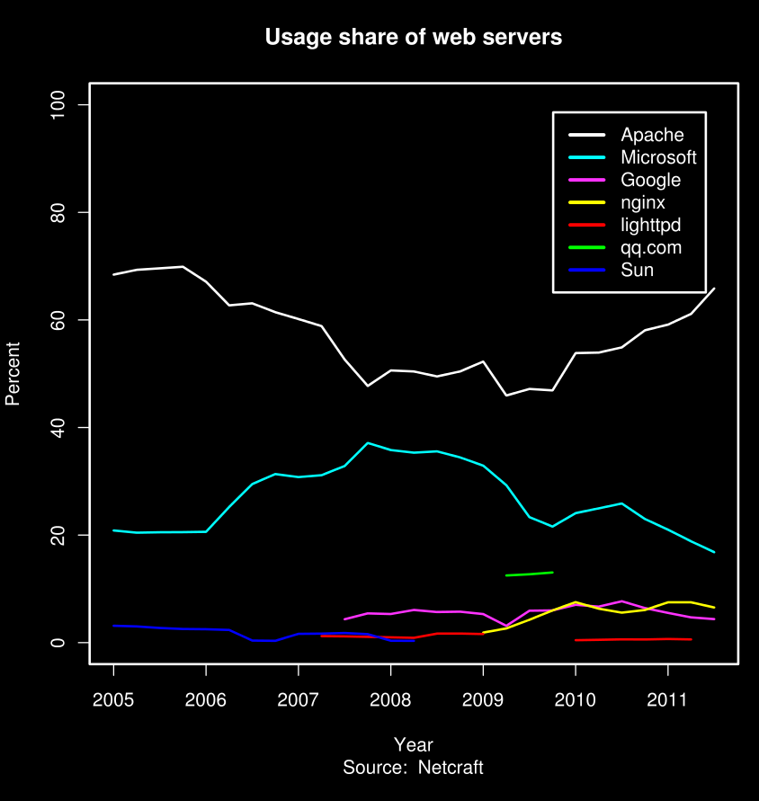
Web Servers Market Share March 2015
Market share of the top million busiest sites
Apache
49.35% (493,463)
nginx
21.22% (212,151)
IIS (by Microsoft)
12.21% (122,069)
GWS (by Google)
2.44% (24,434)
Source

Slide 17
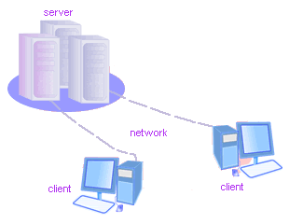
Client-Server Architecture
The Classical Client-Server Model
17

Slide 18
Client-Server Architecture
The client-server model consists of:
Server – a single machine or cluster of machines that provides web applications (or services) to multiple clients
Examples:
Web server running PHP scripts or ASP.NET pages
IIS based Web server
WCF based service
Services in the cloud

Slide 19
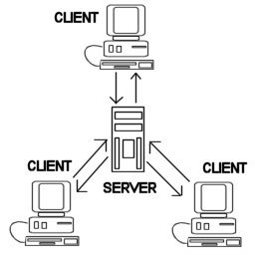
Client-Server Architecture
The client-server model consists of:
Clients –software applications that provide UI (front-end) to access the services at the server
Examples:
Web browsers
WPF applications
HTML5 applications
Silverlight applications
ASP.NET consuming services

Slide 20




The Client-Server Model
Client
Machine
network connection
network connection
Mobile
Client
network connection
Server
Desktop
Client

Slide 21
Client-Server Model – Examples
Web server (Apache, IIS) – Web browser
FTP server (ftpd) – FTP client (FileZilla)
EMail server (qmail) – email client (Outlook)
SQL Server – SQL Server Management Studio
BitTorrent Tracker – Torrent client (μTorrent)
DNS server (bind) – DNS client (resolver)
DHCP server (wireless router firmware) – DHCP client (mobile phone /Android DHCP client/)
SMB server (Windows) – SMB client (Windows)

Slide 22
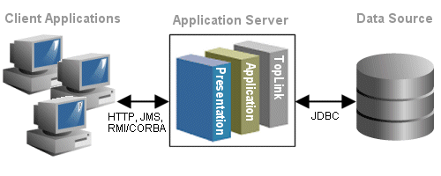
3-Tier / Multi-Tier Architectures
Classical Layered Structure of Software Systems

Slide 23
The 3-Tier Architecture
The 3-tier architecture consists of the following tiers (layers):
Front-end (client layer)
Client software – provides the UI of the system
Middle tier (business layer)
Server software – provides the core system logic
Implements the business processes / services
Back-end (data layer)
Manages the data of the system (database / cloud)

Slide 24

The 3-Tier Architecture Model
Data Tier
(Back-End)
Middle Tier
(Business Tier)
Client Tier (Front-End)
Client
Machine
network
network
Mobile
Client
network
Database
Business
Logic
Desktop
Client

Slide 25

Typical Layers of the Middle Tier
The middle tier usually has parts related to the front-end, business logic and back-end:
Presentation Logic
Implements the UI of the application (HTML5, Silverlight, WPF, …)
Business Logic
Implements the core processes / services of the application
Data Access Logic
Implements the data access functionality (usually ORM framework)

Slide 26
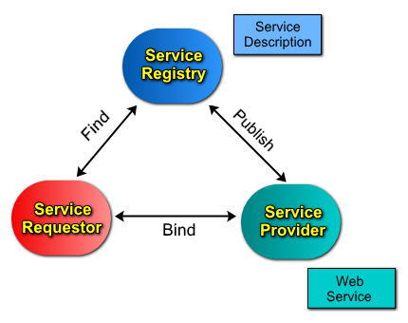


Service-Oriented Architecture (SOA)

Slide 27
What is a Service?
In the real world a "service" is:
A piece of work performed by a service provider
Provides the client (consumer) some desired result by some input parameters
The requirements and the result are known
Easy to use
Always available
Has quality characteristics (price, execution time, constraints, etc.)

Slide 28





What is "Cloud"?

Slide 29
What is Cloud?
Cloud ≈ multiple hardware machines combine their computing power and resources
Share them between multiple applications
To save costs and use resources more efficiently
Public clouds
Provide computing resources on demand
Publicly in Internet
Paid or free of charge (to some limit)
Amazon AWS, Google App Engine, Microsoft Azure, Rackspace, PHPFog, Heroku, AppHarbor

Slide 30
Cloud Computing Models
Infrastructure as a Service (IaaS)
Virtual machines in the cloud on demand
Users install the OS and software they need
Platform as a Service (PaaS)
Platform, services and APIs for developers
E.g. Java + JBoss + JSF + JPA + MongoDB or JavaScript + Node.js + MongoDB + RabbitMQ
Software as a Service (SaaS)
Hosted application on demand (e.g. WordPress)

Slide 31
Web Technologies Basics
?
?
?
?
?
Questions?
?
?
?
?
?
http://academy.telerik.com

Slide 32
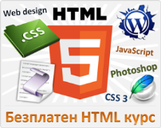



Free Trainings @ Telerik Academy
"Web Design with HTML5, CSS3 and JavaScript" course @ Telerik Academy
html5course.telerik.com
Telerik Software Academy
academy.telerik.com
Telerik Academy @ Facebook
facebook.com/TelerikAcademy
Telerik Software Academy Forums
forums.academy.telerik.com

